Slide 1

Scraping data from Wikipedia
Deepanjan Lamture

Slide 2
Why scrape data
Raw data is hard to analyze
Scraping converts raw data into the required format
By scraping we can find inaccessible data which can further enhance our model

Slide 3
The Code
Imported basic libraries like numpy and pandas.
This code requires a library called Beautiful Soup.
Beautiful Soup is a Python library for pulling data out of HTML and XML files.
ASCII encoding was also required here as Wikipedia pages have different characters.
A sound knowledge of List and arrays in Python will make it easier to create the data-frame.

Slide 4
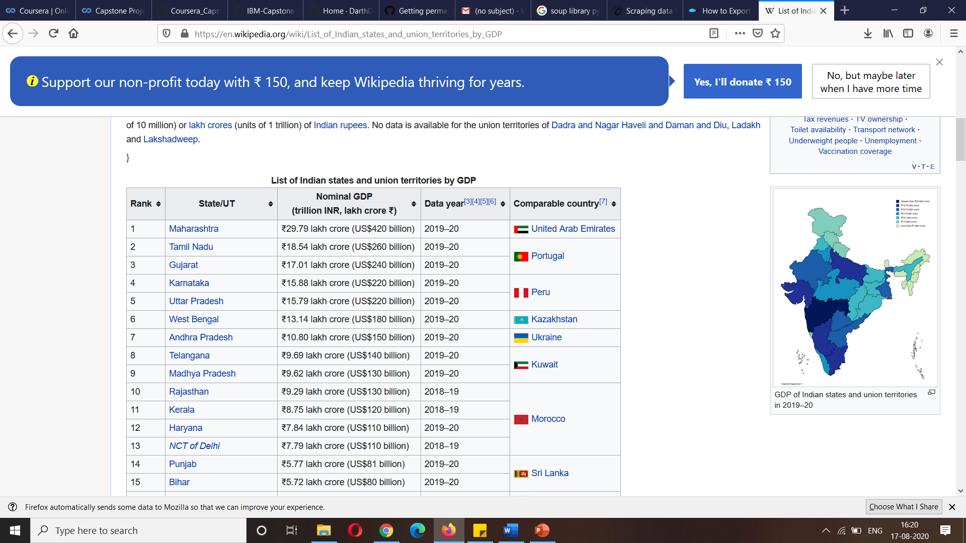
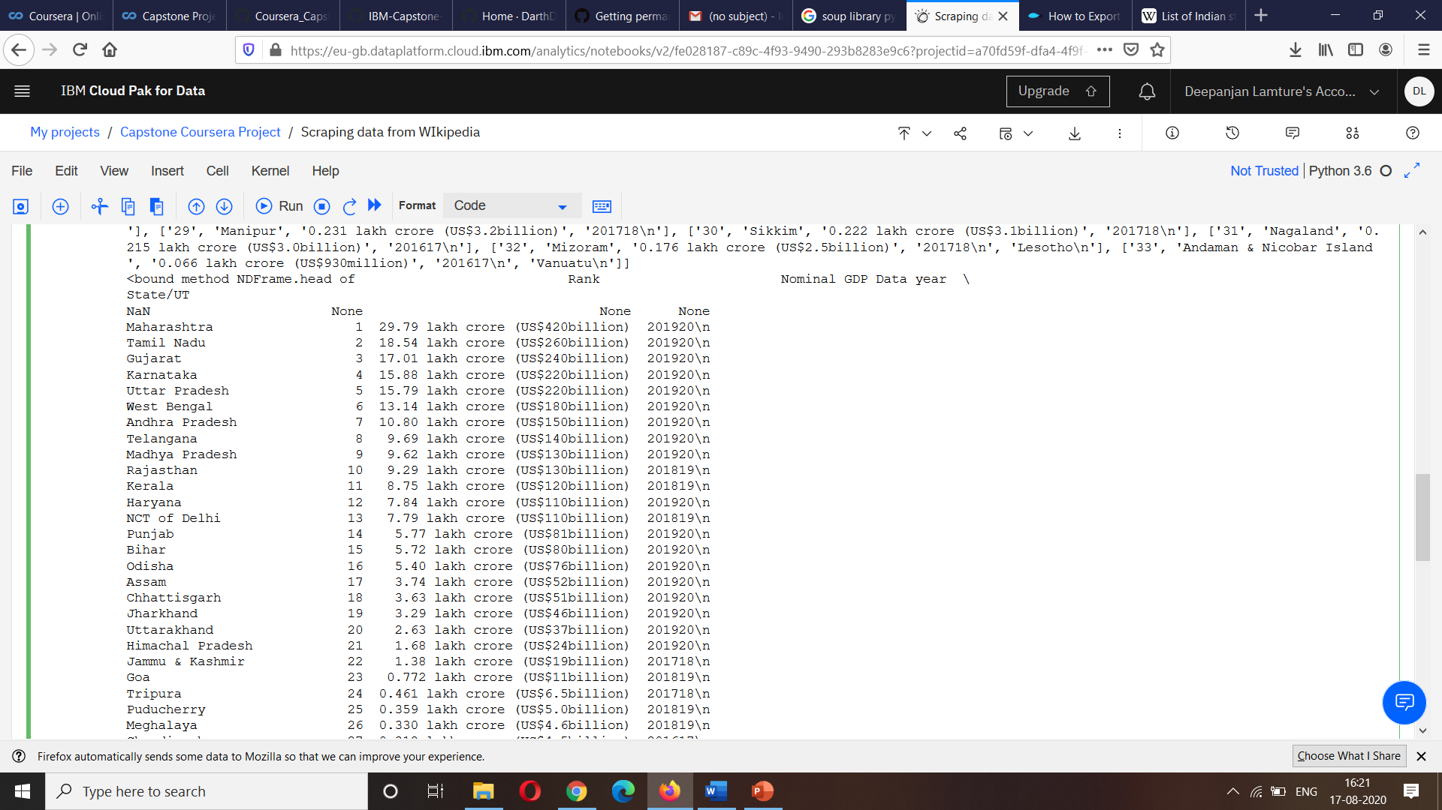
Raw data converted to data frame

Slide 5
Conclusion
The data- frame converted from the raw data can also be acquired in a csv of xlsx format.
We just need to use the following code df_bs.to_csv('beautifulsoup.csv’) .
Although this project was not on a large scale, the code written from scratch by me has helped me understand a lot of things about Data Science which were impossible to gain theoretically.
This scraping tool is not just applicable for Wikipedia but even for other websites with slight customizations.

